Slide 1
Online shopping management system ERD and database
STUDENT NAME STUDENT NUMBER
STUDENT NAME STUDENT NUMBER
STUDENT NAME STUDENT NUMBER

Slide 2
AGENDA
INTRODUCTION
WHAT IS DATABASE
WHAT IS ERD
DATABASE OF OSMS
ERD OF OSMS
FUTURE OF OSMS
IMPORTANT FEATURES OF DATABASE
SUMMARY
QUERIES
REFERENCES

Slide 3
INTRODUCTION
For a Business to grow large which totally depends on an electronic platform its bases needs to be strong and error free which in the Online Shopping management system is the Database of the system which needs to be strong in relationships which will allows it to performs complex actions as they are needed also if the database is not properly structured the system might fail as it stores and organizes data in a structured manner and if not it can cause many problems as in performance, data integrity, security and even in scalability and without strong database the system my not be able to perform workload and protect data.

Slide 4
What is Database ?
A database is a structured collection of data designed to store and manage large amounts of information.
Databases are essential for modern software systems and applications.
They provide a reliable and secure way to store, manage, and access data for analysis, reporting, and decision-making.
Databases are managed by a database management system (DBMS), such as MySQL, Oracle, Microsoft SQL Server, and PostgreSQL.In an online shopping management system, a database is used to store and manage information related to products, customers, orders, payments, and other relevant data.
For example, the product database may include information such as product name, description, price, image, availability, and other details. The customer database may include information such as name, address, email, phone number, and other contact details. The order database may include information such as order number, customer details, product details, quantity, price, and payment information.

Slide 5
What is ERD ?
An ERD is a diagram that shows the relationships between different tables in a database. It includes entities (like customers, orders, or products), attributes (like name or address), and relationships (like orders being placed by customers). ERDs are important for designing a well-organized and effective database.
In an online management system, an ERD is used to model relationships between entities such as users, products, orders, payments, and shipping addresses. Each entity has attributes, and the ERD shows how they are related. For example, one customer can place multiple orders (one-to-many), and one order can contain multiple products (many-to-many).

Slide 6
Database of online shopping management system
In the case of an online shopping management system, ER modeling is an ideal choice because it enables us to represent the different components of the system and their relationships. By using an ER model, we can identify the different entities in the system, the relationships between them, and the attributes that describe those entities. This information is essential for developing an effective database schema.
The components relevant to our database design include the following:
Customers: Entity representing buyers, with attributes like ID, name, and contact information.
Orders: Entity representing shopping orders, with attributes like order ID, customer ID, and date.
Deliveries: Entity representing product deliveries to customers, with attributes like delivery ID, order ID, customer ID, product ID, and date.
Sellers: Entity representing vendors selling their products, with attributes like seller ID, product ID, name, and contact address.
Transactions: Entity representing customer transactions, with attributes like transaction ID, customer ID, order ID, product ID, payment ID, amount, and date.
Products: Entity representing available products for sale, with attributes like product ID, name, and price.
These components are interconnected through different relationships, such as the relationship between the customer entity and the shopping orders entity. The relationship between the products entity and the seller entity, and so on. By modeling these relationships, we can create a database schema that effectively captures the different components of the online shopping management system.

Slide 7
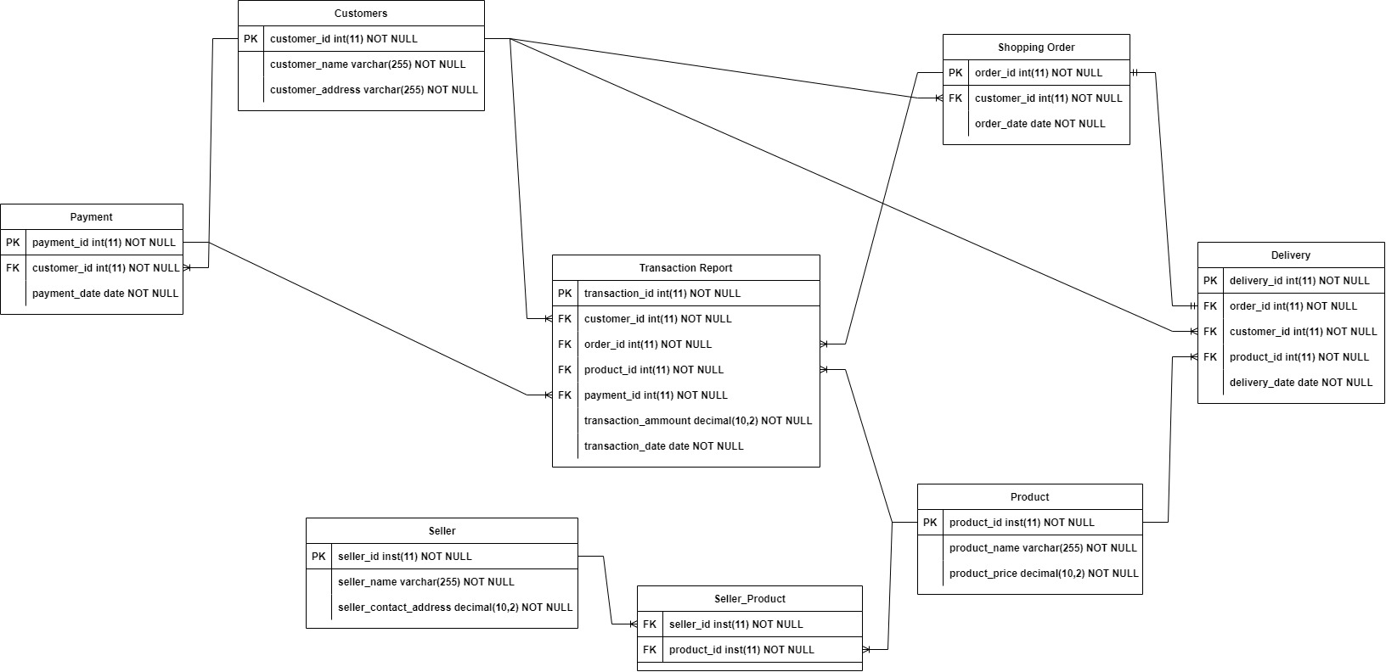
ERD of online shopping management system
The ERD model includes six entities: customer, product, seller, shopping order, delivery, and transaction report. Each entity is represented by a rectangle, and the relationships between entities are represented by lines. The cardinality of each relationship is shown by the symbols at each end of the line.’
The tables are designed to store the data for each entity, with the primary key (PK) and foreign key (FK) constraints specified where necessary. The primary key uniquely identifies each row in the table, and the foreign key establishes a relationship with another table. The attributes for each table are defined based on the information required by the system, as specified in the business rules.

Slide 8
Future of online shopping management system
NoSQL databases are becoming popular for handling large amounts of unstructured data
Big data tools can help businesses analyze and gain insights from massive amounts of data
Data mining can identify patterns and trends to optimize operations and improve customer experience
Data warehousing organizes data for easier access and analysis
Business intelligence tools can provide insights for improving business operations.
The future of online shopping management systems is expected to be shaped by advancements in AI, machine learning, and blockchain technology. These technologies can help to improve the efficiency, security, and accuracy of online shopping systems. By implementing these advancements, businesses can benefit from increased customer satisfaction, improved decision-making, and reduced costs.

Slide 9
Important Features in Database
Certainly! Implementing database security management, backup, and recovery management is essential for ensuring the safety and reliability of our online shopping system. Let me discuss each of these areas in more detail.
Database security management:
Protects data from unauthorized access, data breaches, and cyberattacks.
Implements access controls and encryption techniques.
Regularly monitors database for unusual activity and takes appropriate measures to mitigate risks.
Backup management:
Ensures availability of data in case of disasters or system failures.
Minimizes data loss and enables quick data restoration.
Implements a backup strategy that fits business needs.
Tests backup and restore procedures regularly.
Recovery management:
Enables quick recovery from system failures or data losses.
Defines a disaster recovery plan that includes steps for restoring data, systems, and applications.
Tests recovery procedures regularly to ensure effectiveness in real-world scenarios.

Slide 10
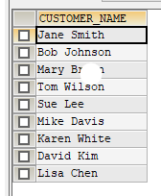
queries
SELECT CUSTOMER_NAME
FROM CUSTOMER
WHERE NOT CUSTOMER_NAME LIKE 'JOHN%'
ORDER BY CUSTOMER_ID;

Slide 11
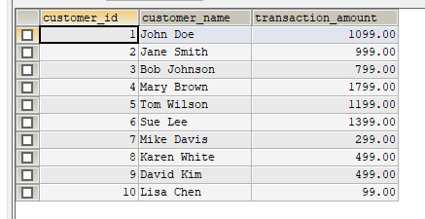
queries
SELECT DISTINCT c.customer_id, c.customer_name, transaction_amount
FROM Customer c
INNER JOIN Transactions t ON c.customer_id = t.customer_id;

Slide 12
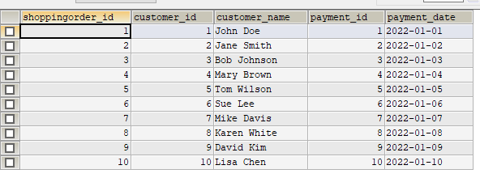
queries
SELECT so.order_id AS shoppingorder_id, c.customer_id, c.customer_name, p.payment_id, p.payment_date
FROM shoppingorder so
INNER JOIN customer c ON so.customer_id = c.customer_id
INNER JOIN payment p ON c.customer_id = p.customer_id;

Slide 13
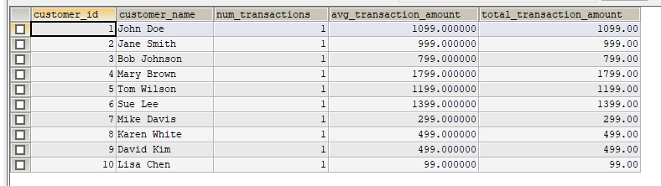
queries
SELECT c.customer_id, c.customer_name, COUNT(transaction_amount) AS num_transactions, AVG(transaction_amount) AS avg_transaction_amount, SUM(transaction_amount) AS total_transaction_amount
FROM customer c
LEFT JOIN transactions tr ON c.customer_id = tr.customer_id
GROUP BY c.customer_id
ORDER BY c.customer_id ASC;

Slide 14
SUMMARY
In conclusion, by implementing these future trends in database systems, we can improve our online shopping system's efficiency and reliability, gain insights into our business operations, and make informed decisions. However, we must also prioritize database security management, backup and recovery management to ensure the safety of our data.

Slide 15
refrences
“Online Shopping System.” Student Project Guidance & Development, 8 Nov. 2017, https://studentprojectguide.com/php/online-shopping-system/.
What Are the Advantages and Disadvantages of Online Shopping. https://www.tutorialspoint.com/what-are-the-advantages-and-disadvantages-of-online-shopping
“Online Shopping System.” Student Project Guidance & Development, 8 Nov. 2017, https://studentprojectguide.com/php/online-shopping-system/.
Sullivan, M. (2022, July 27). The Importance of Entity Relationship Diagrams.
https://blog.hubgem.co.uk/the-benefits-of-entity-relationship-diagrams

Slide 16
THANK YOU ☺
STUDENT NAME STUDENT NUMBER
STUDENT NAME STUDENT NUMBER
STUDENT NAME STUDENT NUMBER

